Slide 1
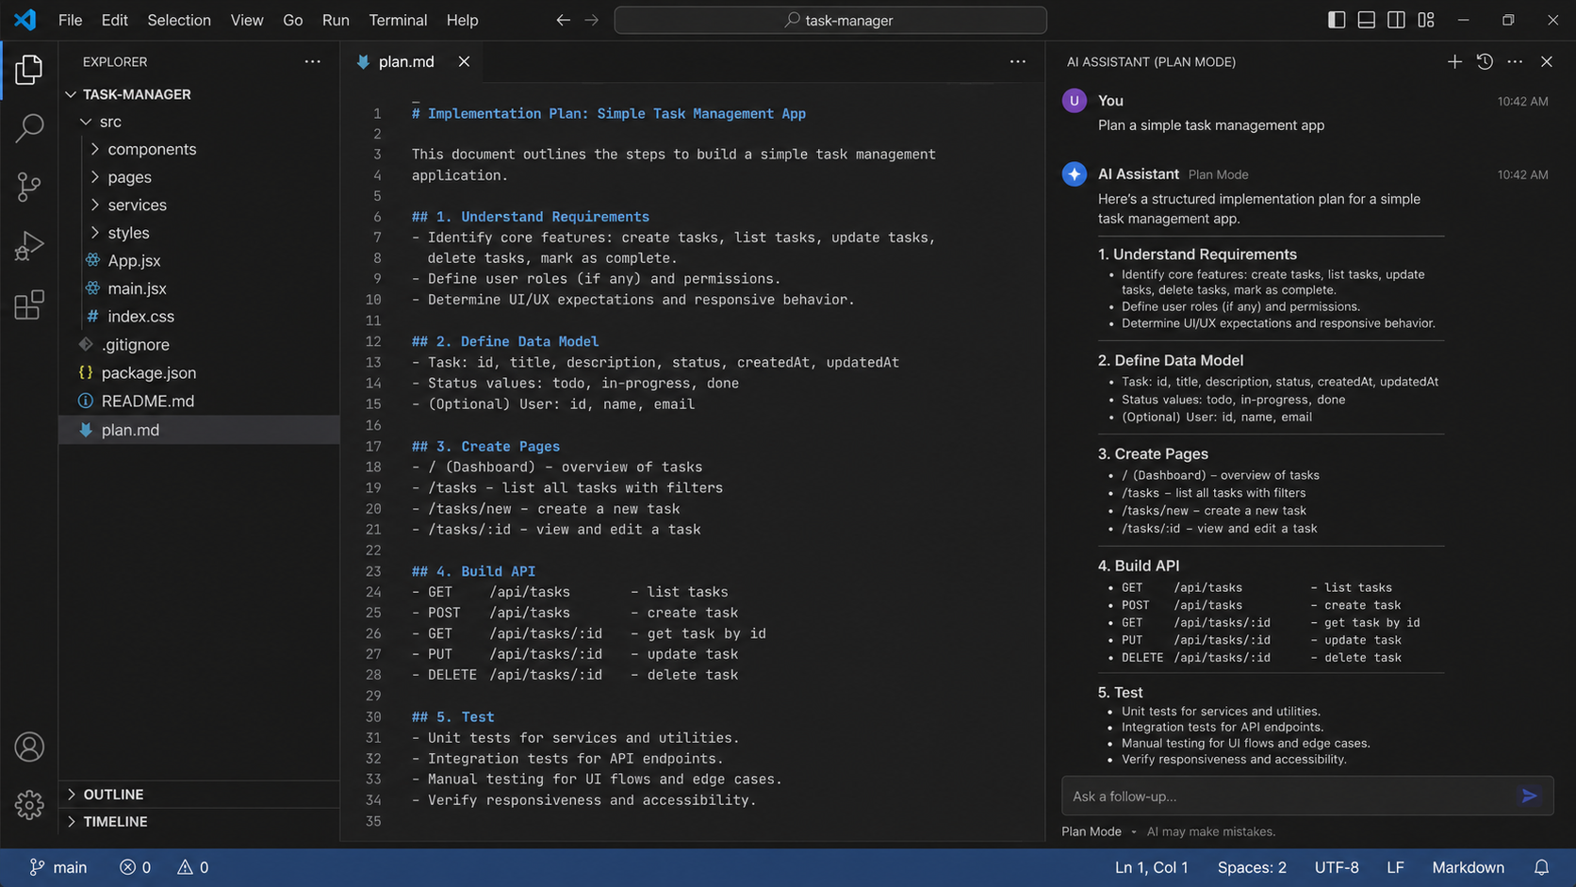
Prompt Engineering
Plan Mode, Build Mode, Image Prompts, and Shared AI Workflows
Simple English. Practical prompts. Real project workflow.
Lecture deck

Slide 2
What students will learn
By the end, they can move from idea to working project using repeatable prompts.
Plan first
Build in steps
Use AI to create a clear project plan before coding.
Turn the plan into small, testable build tasks.
Create visuals
Share prompts
Write strong Gemini / Nano Banana image prompts for app photos.
Store skills and prompts in a GitHub repo so the team can reuse them.
Prompt Engineering Workshop
02

Slide 3
The full AI development workflow
Use one workflow from idea to shared reusable assets.
1
2
3
4
5
Idea
Plan Mode
Build Mode
Test
Share
What are we building?
Ask AI to create the plan.
Build one step at a time.
Check bugs and missing parts.
Save prompts and skills in GitHub.
Important: AI is not the project owner. You are. AI helps you plan, build, test, and explain.
Prompt Engineering Workshop
03

Slide 4
Plan Mode: think before building
Plan Mode is used before coding or before making big changes.
• Use it when the task is unclear or large.
• Ask AI to break the work into steps.
• Ask for files, pages, data model, API routes, and tests.
• Review the plan before starting Build Mode.
Good Plan Mode output = clear scope + ordered steps + risks + test plan.
Prompt Engineering Workshop
04

Slide 5
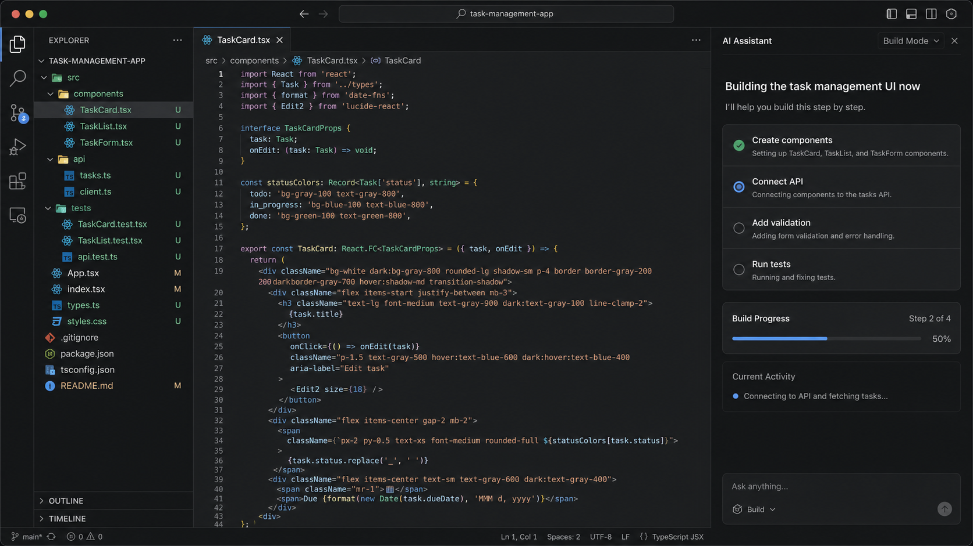
Build Mode: make the plan real
Build Mode is used when the next task is clear enough to implement.
• Give one clear build task at a time.
• Tell AI which files it may change.
• Ask it to explain changes after coding.
• Run tests or ask for a testing checklist.
• Review changes before you accept them.
Simple rule: plan with a map, build with small steps.
Prompt Engineering Workshop
05

Slide 6
Plan Mode vs Build Mode
They are not competitors. They are two stages of the same workflow.
Mode Best for Main output Human job
Plan big or unclear task steps and structure approve or correct plan
Build small clear task code or files review and test changes
Review after changes risks and fixes decide what to keep
Never ask AI to “build the whole app” at once. Ask it to plan first, then build small pieces.
Prompt Engineering Workshop
06

Slide 7
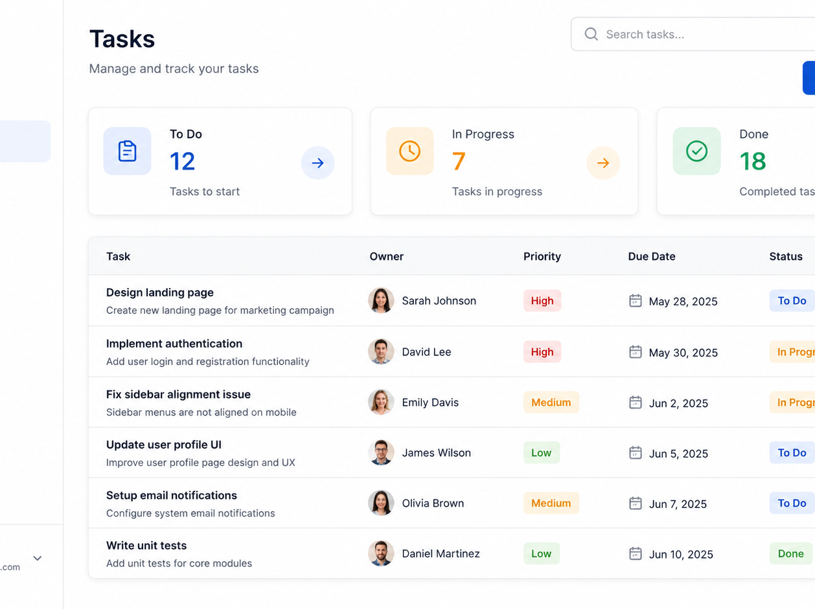
Practice project: Task Management App
A simple project is better for learning because every part is visible.
• Dashboard with task statistics
• Task list with status and priority
• Create, update, and delete tasks
• Assign a task to a user
• Filter by status, owner, and due date
Core entity:
Task { id, title, description, status, priority, ownerId, dueDate }
Prompt Engineering Workshop
07

Slide 8
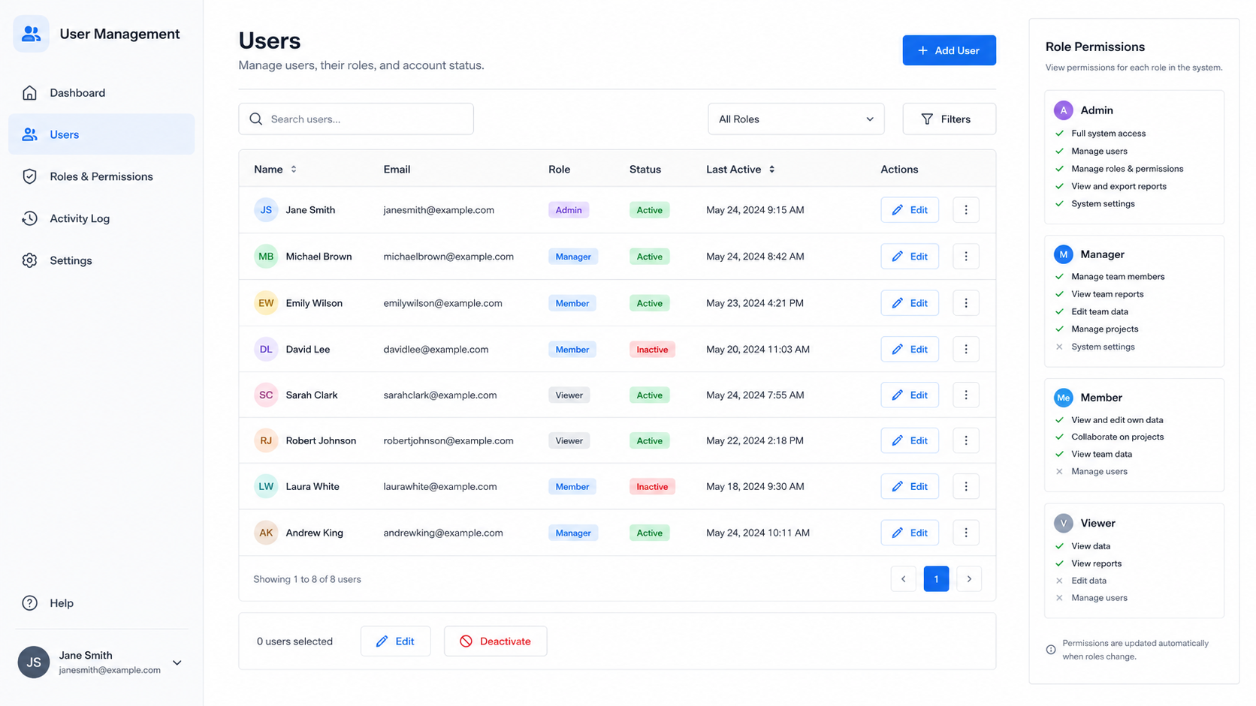
Practice project: User Management
User management teaches roles, permissions, and safer application design.
• Add and edit users
• Show user role and status
• Define Admin, Manager, Member, Viewer
• Control who can create or delete data
• Keep an activity log for important changes
Roles make the app more realistic and easier to discuss.
Prompt Engineering Workshop
08

Slide 9
Requirements prompt for the project
Start with a prompt that describes the project clearly.
You are a senior product engineer.
I want to build a simple Task Management web app for students.
Features:
- Create, edit, delete, and complete tasks
- Assign tasks to users
- User roles: Admin, Manager, Member, Viewer
- Filters by status, priority, owner, and due date
Create a clear project plan before writing code.
Include pages, data model, API routes, components, and tests.
Use simple language.
• Role: tell AI what expertise to use.
• Goal: describe what we want to build.
• Features: list the expected behavior.
• Output: ask for a plan, not code yet.
• Style: request simple language.
Prompt Engineering Workshop
09

Slide 10
Plan Mode prompt structure
A strong planning prompt gives the AI boundaries.
1. Describe the app goal in one sentence
2. List the main features
3. Name the users and roles
4. Ask for pages and components
5. Ask for data model and API routes
6. Ask for build order
7. Ask for risks and tests
Plan this project before coding.
Return:
1. Scope
2. Pages
3. Data model
4. API routes
5. Components
6. Build order
7. Testing plan
8. Risks and open questions
Planning prompts should ask for decisions, not just information.
Prompt Engineering Workshop
10

Slide 11
How to review the plan
Do not accept the first plan blindly. Check if it is realistic.
Good signs
Warning signs
• The plan is divided into small tasks.
• The data model is simple and clear.
• The build order starts with the basics.
• Tests and risks are included.
• The plan is too big for the time available.
• It adds features you did not ask for.
• It skips authentication or permissions.
• It does not explain testing.
Prompt Engineering Workshop
11

Slide 12
Data model from Plan Mode
The data model is the skeleton of the app.
User
- id
- name
- email
- role: admin | manager | member | viewer
- status: active | inactive
Task
- id
- title
- description
- status: todo | in_progress | done
- priority: low | medium | high
- ownerId
- dueDate
• Keep the first version small.
• Use simple names that students understand.
• Connect tasks to users with ownerId.
• Use fixed status and role values.
• Add more fields only when needed.
Prompt Engineering Workshop
12

Slide 13
Pages and routes
Routes help students understand how the app is organized.
Page Route Purpose
Dashboard / Show task statistics
Tasks /tasks List, filter, and update tasks
New Task /tasks/new Create a task
Users /users Manage users and roles
Settings /settings App options and profile
Ask AI to explain routes before building. This makes the project easier to teach.
Prompt Engineering Workshop
13

Slide 14
Component plan
Components are reusable pieces of the interface.
TaskCard
TaskList
TaskForm
TaskFilters
UserTable
RoleBadge
Sidebar
StatsCard
Ask Build Mode to create one component at a time, not all components together.
Prompt Engineering Workshop
14

Slide 15
Build Mode prompt structure
Build prompts must be smaller and more direct than planning prompts.
Build only the TaskCard component.
Context:
- React + TypeScript
- Use the existing Task type
- Status values: todo, in_progress, done
Requirements:
- Show title, priority, owner, due date, and status
- Add Edit and Complete buttons
- Keep the design simple and responsive
After coding, explain what changed and how to test it.
• One task only
• Mention the file or component
• Include context and constraints
• Tell AI what not to change
• Ask for explanation and test steps
Prompt Engineering Workshop
15

Slide 16
Build task 1: create the UI
Start with screens and components before adding complex logic.
Build the first UI version.
Create:
- Sidebar
- Dashboard summary cards
- Task table
- Users table placeholder
Do not connect a real backend yet.
Use mock data only.
Keep the layout clean and easy to read.
First make it visible. Then make it functional.
Prompt Engineering Workshop
16

Slide 17
Build task 2: add CRUD actions
CRUD means create, read, update, and delete.
• Create task: add new task from a form.
• Read tasks: show tasks in table or cards.
• Update task: edit title, owner, priority, and status.
• Delete task: remove task after confirmation.
• Complete task: quick status change to done.
Now add CRUD behavior for tasks.
Use local state first.
Do not add database code yet.
Acceptance criteria:
- I can create a task
- I can edit a task
- I can delete a task
- I can mark a task as done
- Empty form fields show simple errors
Prompt Engineering Workshop
17

Slide 18
Build task 3: users and roles
Roles protect the app from unsafe or confusing actions.
• Admin: full access
• Manager: manage tasks and team users
• Member: update own tasks
• Viewer: read only
• Show disabled buttons when action is not allowed
Add role-based UI rules.
Do not hide every blocked action.
Show disabled buttons with a short reason.
Prompt Engineering Workshop
18

Slide 19
Testing prompts
Testing prompts help students learn quality, not only speed.
Review this app as a QA tester.
Find:
- 5 possible bugs
- 5 missing edge cases
- 5 accessibility issues
- 5 usability improvements
Return a table with issue, impact, and suggested fix.
• Test empty fields.
• Test invalid dates.
• Test long task titles.
• Test role permissions.
• Test mobile layout.
• Test keyboard navigation.
Prompt Engineering Workshop
19

Slide 20
Review and refactor prompts
Use AI to improve code after it works.
Review prompt
Refactor prompt
• Review this code for bugs and unclear logic.
• Find duplicate code and risky patterns.
• Do not rewrite yet. Only explain issues.
• Refactor only the selected component.
• Keep the same behavior and props.
• Make it easier to read and test.
Separate review from refactor. First understand the problems, then change the code.
Prompt Engineering Workshop
20

Slide 21
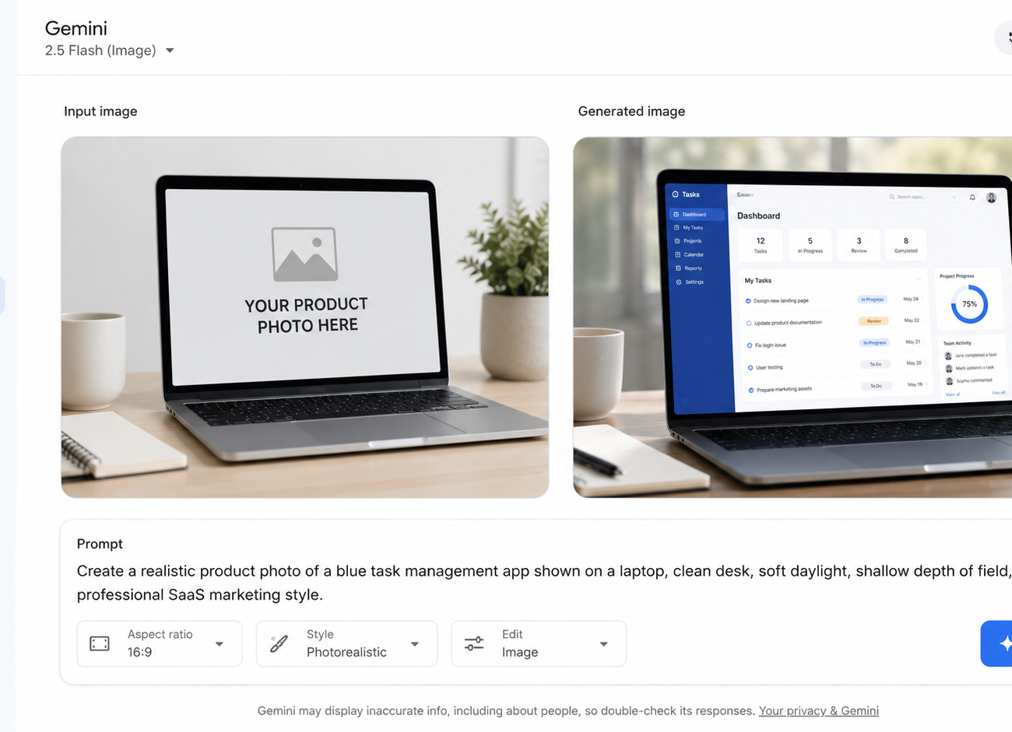
Gemini / Nano Banana for project photos
Use image generation to create realistic visuals for slides, demos, and marketing.
• Create hero images for the app.
• Show the app on a laptop or phone.
• Generate classroom or teamwork scenes.
• Edit an existing photo while keeping key details.
• Use the same style across all visuals.
Nano Banana is useful when the image needs to match a detailed prompt or edit an existing image.
Prompt Engineering Workshop
21

Slide 22
Photo prompt anatomy
A good image prompt is like a mini creative brief.
1. Subject: what is in the image
2. Setting: where it is happening
3. Style: realistic, clean, cinematic, etc.
4. Composition: angle, distance, framing
5. Lighting: daylight, soft shadows, studio light
6. Details: screen content, colors, objects
7. Restrictions: what to avoid
Formula:
[Subject] + [setting] + [style] + [composition] + [lighting] + [details] + [avoid]
Example: “A realistic photo of a laptop showing a task management dashboard, clean desk, soft daylight, shallow depth of field, professional SaaS style, no brand logos.”
Prompt Engineering Workshop
22

Slide 23
Nano Banana prompt templates
Copy, edit, and reuse these templates.
1. SaaS hero image
Create a realistic product photo of [APP] shown on a laptop, clean desk, soft daylight, professional SaaS style, 16:9.
2. App mockup
Create a clean UI mockup for [FEATURE], modern web dashboard, readable text, simple layout, blue accent color.
3. Classroom scene
Create a realistic classroom workshop photo where students are learning [TOPIC], laptops open, professional training environment.
For consistent results, keep the same visual style words across all prompts.
Prompt Engineering Workshop
23

Slide 24
Photo editing prompts
When editing an image, clearly say what must stay unchanged.
Good editing prompt
Bad editing prompt
• Keep the person, face, clothing, and lighting unchanged.
• Replace only the laptop screen with the app dashboard.
• Make the screen look realistic with reflections.
• Do not add logos or extra people.
• Make it better.
• Change the photo into something professional.
• Add a cool app screen.
• Fix everything.
Prompt Engineering Workshop
24

Slide 25
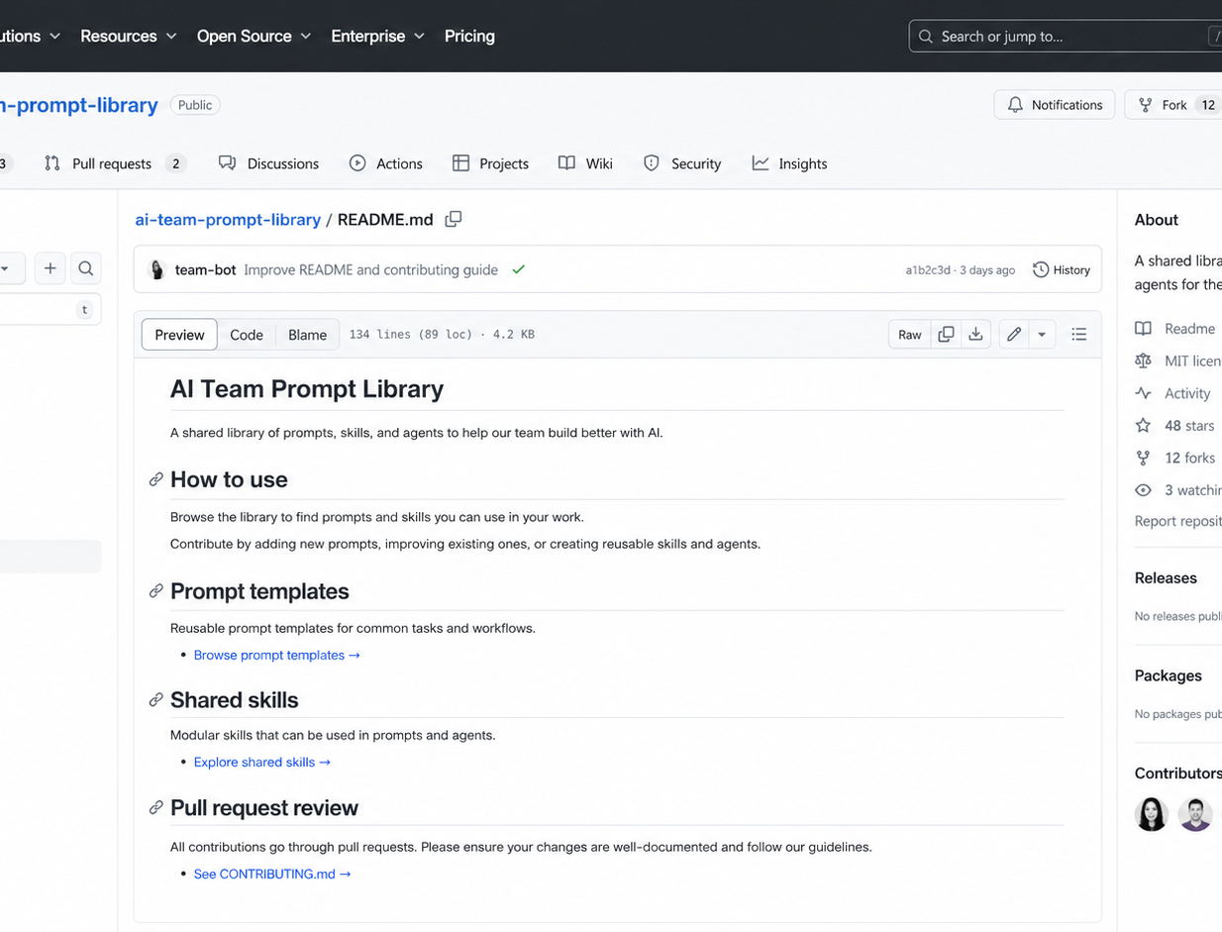
Why share prompts and skills through GitHub?
A GitHub repo turns individual prompts into team knowledge.
• Everyone uses the same tested prompts.
• Changes are visible through commits.
• Students can submit improvements with pull requests.
• Skills become reusable learning assets.
• The repo becomes documentation for the course.
Prompt Engineering Workshop
25

Slide 26
Recommended GitHub repo structure
Keep the repo simple so students can understand it quickly.
ai-team-prompt-library/
├── README.md
├── CONTRIBUTING.md
├── prompts/
│ ├── plan-mode/
│ ├── build-mode/
│ ├── testing/
│ └── image-generation/
├── skills/
│ ├── task-app-planner/
│ │ └── SKILL.md
│ └── ui-reviewer/
│ └── SKILL.md
├── agents/
│ ├── planner.agent.md
│ └── reviewer.agent.md
└── examples/
• README explains how to use the repo.
• prompts folder stores reusable prompt templates.
• skills folder stores complete skill instructions.
• agents folder stores AI coding agent behavior.
• examples folder shows real usage.
Prompt Engineering Workshop
26

Slide 27
Example shared skill file
A skill is a reusable instruction package for a repeated task.
# task-app-planner
Use this skill when the user wants to plan a small web app.
## Steps
1. Understand the app goal and audience.
2. List features and user roles.
3. Define pages and routes.
4. Propose the data model.
5. Propose components and API routes.
6. Create a build order.
7. Add a testing checklist.
## Style
Use simple English. Keep the plan practical.
• Name tells the purpose.
• When to use tells the AI when to apply it.
• Steps make the process repeatable.
• Style keeps outputs consistent.
• Examples help students learn faster.
Prompt Engineering Workshop
27

Slide 28
Contribution workflow for students
Students can improve the shared library like a real development team.
1
Fork or branch
Create a safe place to edit.
2
Add prompt
Place it in the correct folder.
3
Test it
Run the prompt and save the result.
4
Open PR
Explain what changed and why.
5
Review
Teacher or peers approve it.
Every prompt should include: purpose, input needed, prompt text, expected output, and one example.
Prompt Engineering Workshop
28

Slide 29
Classroom lab: 60 to 90 minutes
Students practice the full workflow on a small project.
Time Activity Output
10 min Choose task or user management feature Clear feature goal
15 min Write Plan Mode prompt Reviewed plan
25 min Build one component or page Working UI part
15 min Write tests and review prompt Bug list and fixes
15 min Add prompt to GitHub repo Pull request or commit
Finish with a 2 minute demo: what they planned, what they built, what prompt they shared.
Prompt Engineering Workshop
29

Slide 30
Final checklist
Use this checklist every time you work with AI coding tools.
1. Start with the project goal
2. Use Plan Mode before big changes
3. Review and simplify the plan
4. Use Build Mode for one clear task
5. Test before moving to the next step
6. Use Gemini / Nano Banana for clean project visuals
7. Save good prompts and skills in GitHub
8. Improve the shared library through review
Best workflow: Plan → Build → Test → Review → Share
References used for deck accuracy: Google Gemini Image / Nano Banana, Google Cloud prompting guide, GitHub Copilot custom instructions, VS Code custom agents.
Main message: AI helps more when the work is clear, small, and shared.
Prompt Engineering Workshop
30
Notes:
Sources checked: Google Gemini image generation and Nano Banana docs, Google Cloud Nano Banana prompting guide, GitHub Copilot custom instructions documentation, VS Code custom agents documentation.

